Slide 1
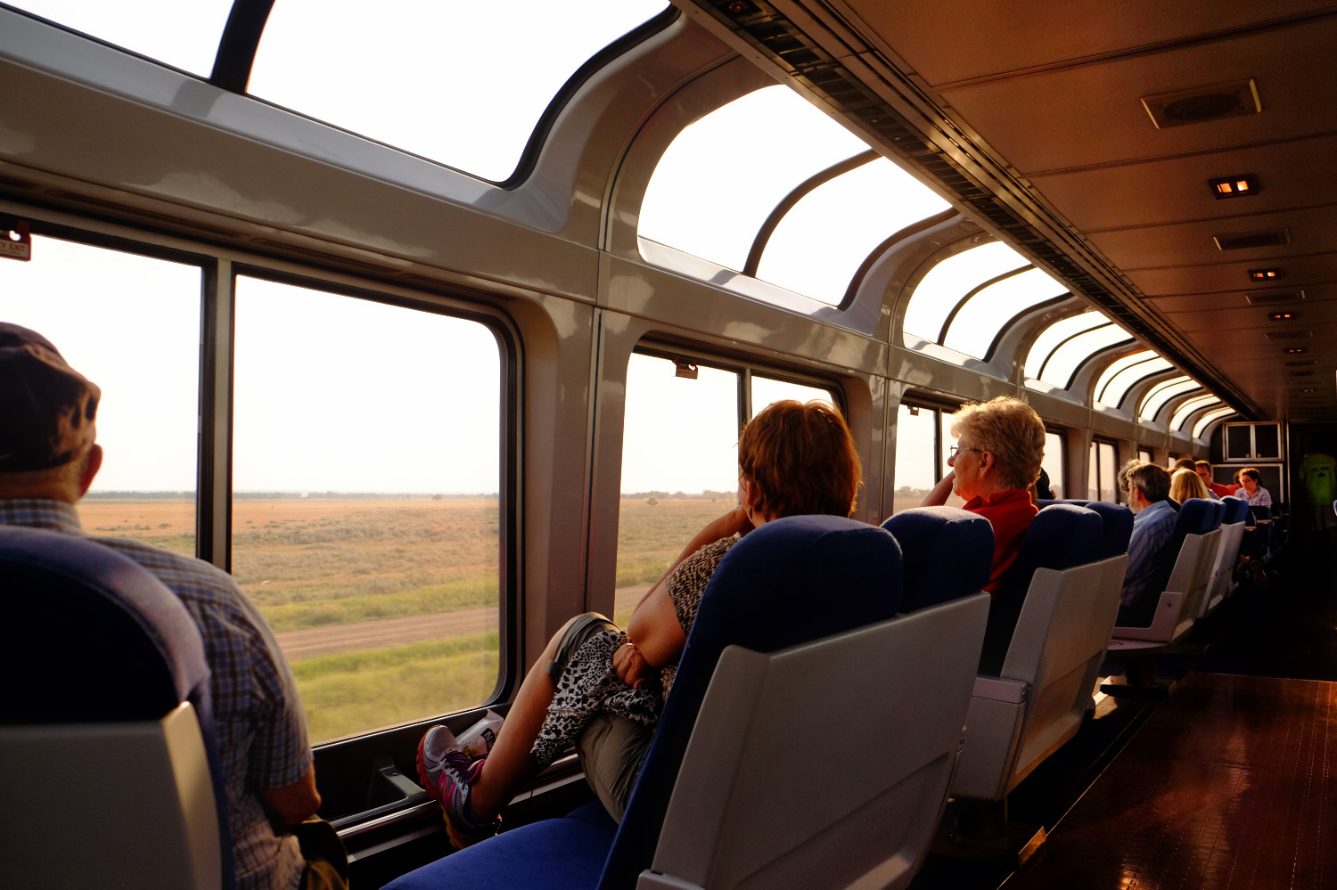
CDS-486 Homework 3
Fatma Abdulwahab, Alexis Barrett, Jared McDonough, Matthew Miller, Nicky Solares
Students in CDS-486

Slide 2
Do you feel overly stressed by the pressure of midterms?
Then you should take a relaxing vacation over spring break!
For a limited time only, you can buy tickets for an unforgettable trip across the country by train.
10 DAYS!
6425 miles covered!

Slide 3
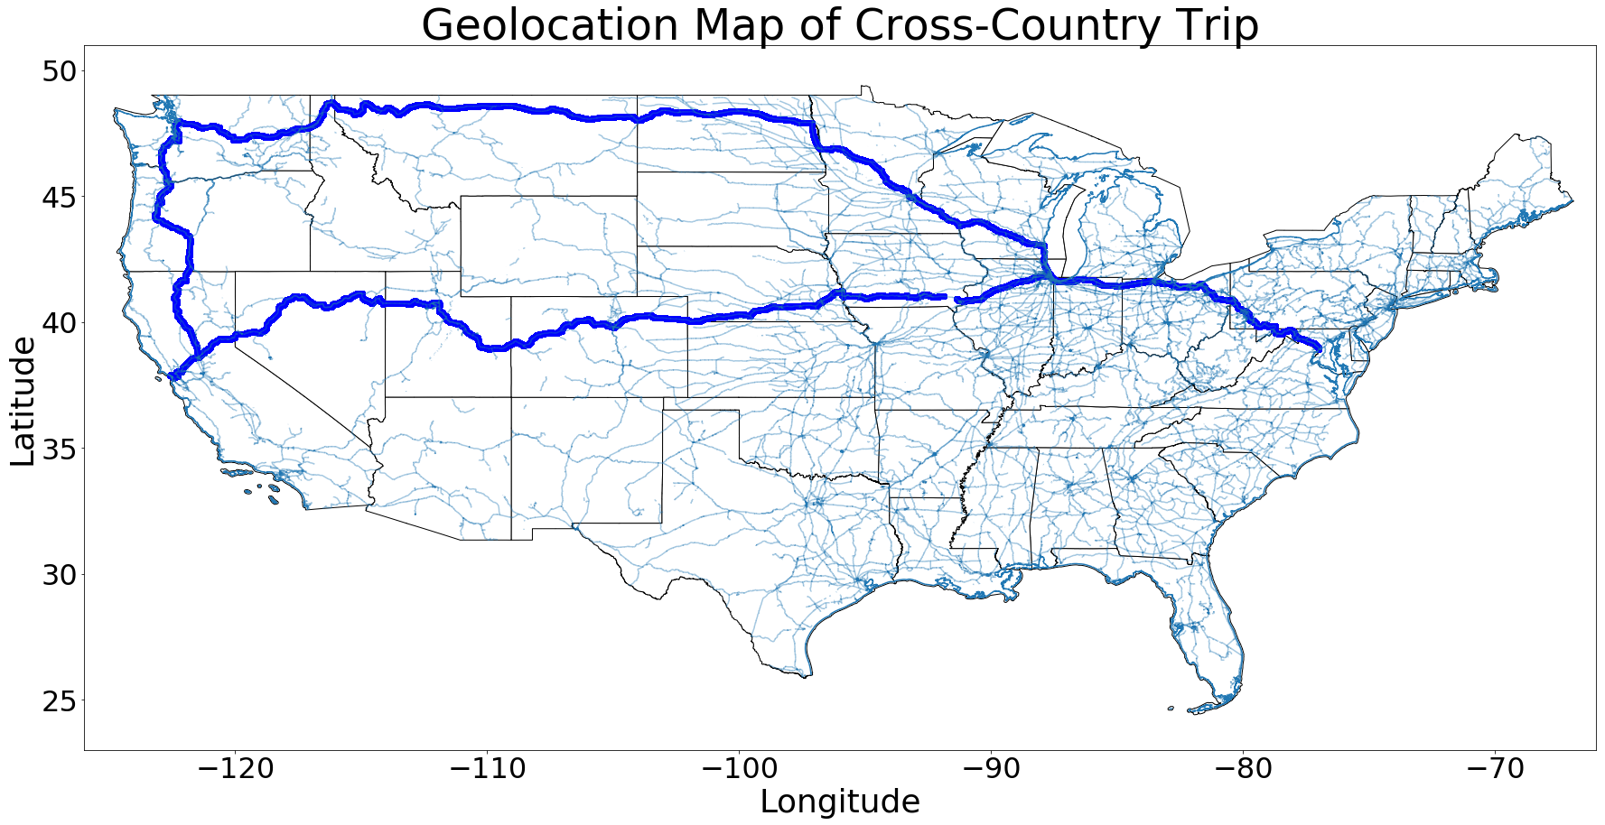
Just take a look at that route!

Slide 4
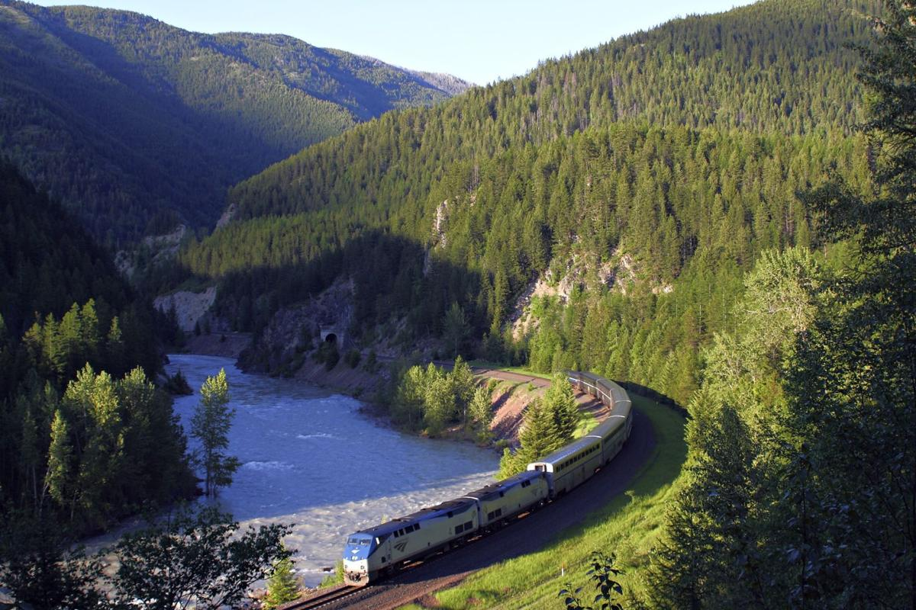
We’ll take you through a whopping 20 states across the country
Take a stroll to the observation cars and enjoy our floor-to-ceiling windows.
As we ride along, we’ll see scenic views and national landmarks such as the Rock and Roll Hall of Fame in Ohio, Glacier National park in Montana, and the Colorado National Monument park in Colorado!

Slide 5
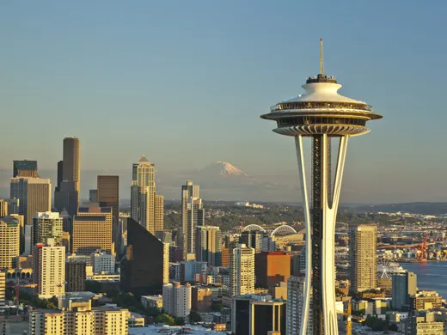
We will spend an incredible day in Seattle, Washington!
See the famous Seattle Space Needle!
Maybe after, go next door and visit the amazing Chihuly Garden and Glass!
Then you could enjoy a fresh seafood dinner at Pike Place Market!
You’ll spend your night at the Hilton Seattle!

Slide 6
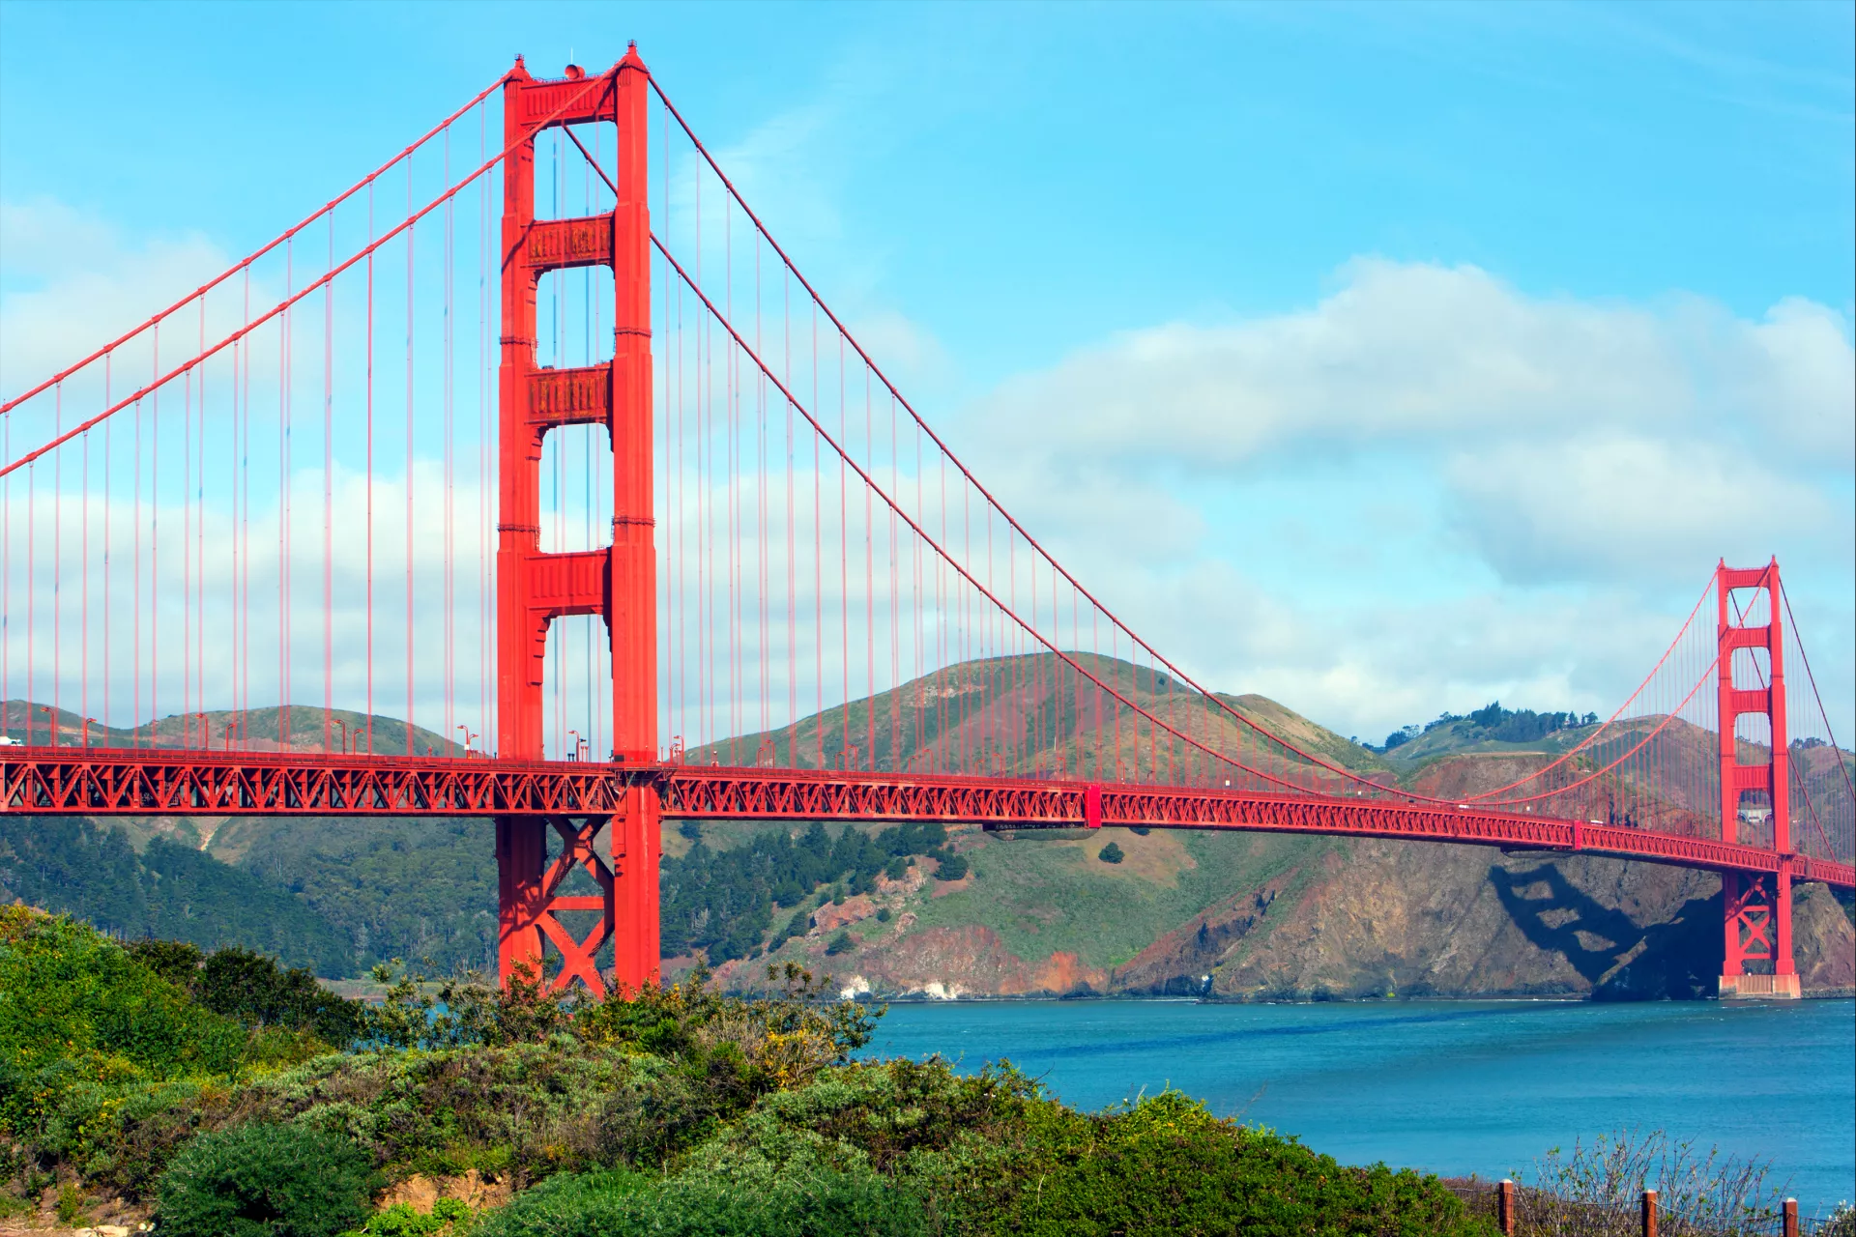
Then we’ll spend a day in San Francisco, California!
See the Golden Gate Bridge in all of its glory!
Take a boat tour to see Alcatraz Island!
Stop by the Fisherman’s Wharf for a mouthwatering crab meal!
Then you’ll spend the night at the Pier 2620 Hotel!

Slide 7
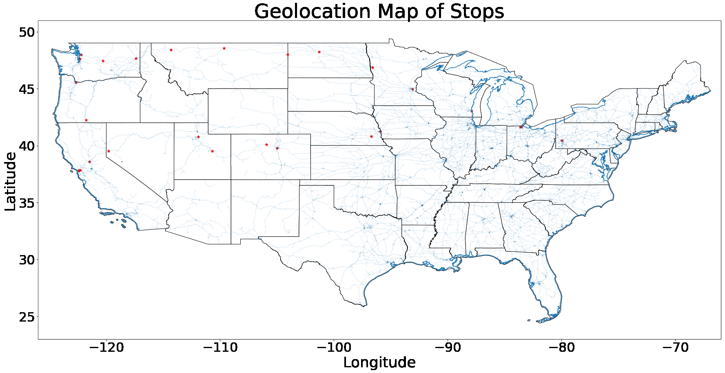
Take advantage of this offer and see the country like you’ve never seen it before!
Visit 20 states, and see plenty of small towns in any of the 37 stops the train will make
Enjoy two wonderful cities for a day
See over 30 national landmarks
And you wont have to worry about driving or getting a middle seat on a plane!
Buy your tickets today!

Slide 8
Image Credit
https://www.usatoday.com/story/travel/destinations/2018/05/24/seattle-space-needle/641567002/
https://www.dkfindout.com/us/earth/landmarks-world/golden-gate-bridge/
http://www.bikabout.com/blog/take-your-bike-on-amtrak
https://lacrossetribune.com/skip-the-flight-board-the-train-to-glacier-national-park/article_482884f3-e399-5769-b536-1168d8aa01f4.html

